Slide 1

Improving Integration between Bahmni EMR and Odoo Using Messaging-Oriented Middleware
By: Moeketsi John Ntaole
Lehlohonolo Matsikane Moeling
201902695
201902032
Supervisor: Mr. Lebajoa Mphatsi

Slide 2
Table of contents
01
04
02
05
03
06
Overview
Methodology
Background
Deliverables and Time frame
Problem,Solution and scope
Conclusion

Slide 3

01
Overview
Project aims to revolutionize the data synchronization process between Bahmni ERM and Odoo by transitioning from the current Atom-feed-based Change Data Capture (CDC) approach to a more robust Messaging-Oriented Middleware (MOM) solution
1

Slide 4

02
Background
2

Slide 5

Bahmni – HIS Focuses on all aspects of patient care
3

Slide 6



Open source HIS
Components
Bahmni is an open source and free to use Hospital Information system (HIS)
One of the 23 projects recognized as digital public goods
Implemented in more than 500 hospitals across 50 courtiers
Lesotho implementation in work
Bahmni combines three open source products
OpenMRS Distribution: For electronic medical recording
OpenERP: For Hospital Operations
OpenELIS: Lab information management system
Feature List
4

Slide 7
Integration and Interoperability
How does Bahmni provide integration and synchronization between Odoo and OpenMRS?
Atom-Feeds over HTTP
Atom Feed is an implementation of the ATOM protocol in Java
XML-based metadata and data syndication format
Atom represents events as time –ordered series of events called feeds
Designed for RESTful systems to communicate over HTTP
Atom Feeds design
Only point of synchronization is the database
Actors: Server/consumer/server
Event published as pages consuming based on polling
Entries stored indefinitely
New users can easily start polling feed including achieves
Consumption done in batch jobs
Example: If a Doctor orders a Lab (gets published by OpenMRS as publisher), then consumers (OpenELIS/OpenERM) will receive all events, and decides which events it wants to consume.
5

Slide 8

03
Problem, Solution And Scope
6

Slide 9
Problem
Lack of real-time Data Synchronization
Atom feed method does not cater for real time syncronization
Poor Error Handling
Atom feed does not have any error handling, no acknowledgement of whether data was received or not and does no correction
Reliability
Not all Data events requests are successfully reach destination.
Security
Poor data security policies when exchanging information
7

Slide 10
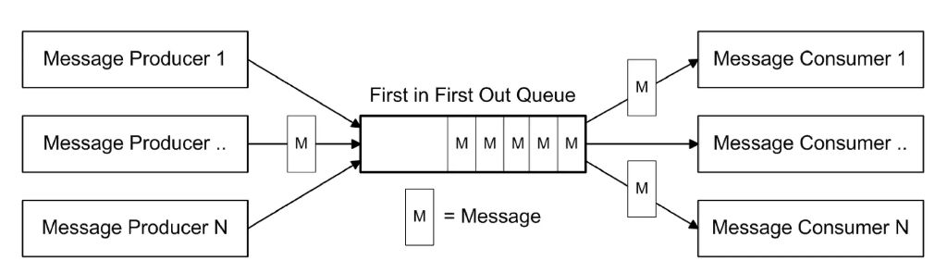
Solution
Message-Oriented Middleware (MOM)
MOM is a software infrastructure supporting receiving and sending of messages between distributed systems
MOM is a more robust method of data synchronization and exchange.
8

Slide 11





Scope Statement
Scope statement
The project aims to enhance the existing CDC (Change Data Capture) integration within the Bahmni ERM (Electronic Medical Record) and Odoo systems by transitioning from the current Atom-feed-based mechanism to a more robust Messaging-Oriented Middleware (MOM) solution. This includes improving real-time data synchronization, error handling, reliability and security measures.
9

Slide 12
Objectives
Assesment
MOM Selection
Create Data consumer modules
Conduct thorough assessment of current Bahmni architecture and MOM options
Apache Kafka
RabbitMQ
Anitio’s , et al
Select appropriate MOM considering performance, reliability , and compatibility with Bahmni ERM and Odoo
Create a data consumer module in Odoo that will consume data events and implement data transformation logic
MOM integration
Create data producer modules
Data migration strategy
Develop a data producer within Bahmni ERM to capture data events and publish them to MOM
Implement selected MOM based solution ensuring realtime syncronization, error handling and data security.
Create detailed strategy to outline the process of transitioning from Atom feed to chosen MOM solution
10

Slide 13
Requirements And Constraints
Functional Requirements
Non-Fuctional Requirements
Detect relevant data changes in OpenMRS and Odoo
Sending and receiving from messages between OpenMRS and middleware
Sending and receiving messages between middleware and Odoo
Message producing and consuming
Error handling and fault tolerance
Real time synchronization
Reliability
Scalability
Compatibility
Resource efficiency
Throughput
11

Slide 14
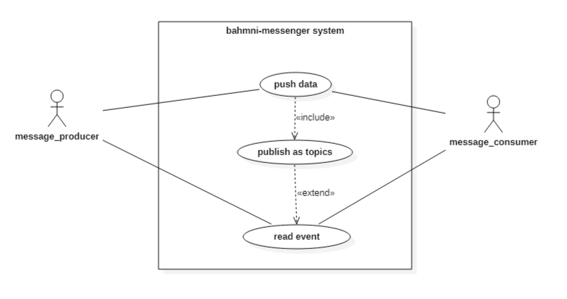
Use Case Diagram
12

Slide 15

Conceptual System design
13

Slide 16

04
Methodology
14

Slide 17

Iterative Incremental development (IID) Model
Divide system into tasks
Data consumer on Odoo
Data producer on OpenMRS
Message middleware
Iterations made for continuous refinement and progress
Iterations repeated until the product reaches a desired level of functionality such as messages reliability.
Enhancements and other features added on each iteration such as scalability to other non functional requirements.
15

Slide 18

05
Deliverables and Time Frame
16

Slide 19
Project activities
Activity | Start date | End date
Initiation | 01/11/2023 | 16/11/2023
Planning | 16/11/2023 | 05/01/2024
Implementation | 06/01/2024 | 25/04/2024
Integration and testing | 20/03/2024 | 14/05/2024
Documentation | 14/05/2024 | 25/05/2024
Closing | 25/05/2024 | 30/05/2023
17

Slide 20
Project roadmap
Initiative | Objective | Nov | Dec | Jan | Feb | Mar | Apr | May | Jun
Initiation | Kick-off the project
Planning | Development plan, identify suitable MOM and Bahmni analysis
Implementation | Data producer, consumer and MOM development
Integration and testing | Combining all components and making sure they work in unison
Documentation | Project Write up and final project report write up
Closing | Project closing party
18

Slide 21

Project Deliverables
Bahmni image
Detailed Migration plan
Final Report
A bahmni image that is integrated using message-oriented middleware.
A plan detailing process of transferring from an atom based Bahmni system to a MOM based system
Final year project report
19

Slide 22
06
Conclusion
In conclusion, our project's shift to Messaging-Oriented Middleware (MOM) technology which addresses synchronization challenges, ensuring real-time data exchange with enhanced security and error handling. This transformation is a strategic move towards a more responsive and interconnected healthcare-ERP landscape.
19

Slide 23
References
Bahmni. Atom Feed Based Synchronization in Bahmni. Available at: .
https://bahmni.atlassian.net/wiki/spaces/BAH/pages/3506200/Atom+Feed+Based+Synchronization+in+Bahmni
Bahmni. Bahmni Online Demo. Available at: .
https://bahmni.atlassian.net/wiki/spaces/BAH/pages/61997323/Bahmni+Online+Demo
Google Docs. Presentation. Available at: .
https://www.bahmni.org/contact-us
Google Docs. Presentation. Available at: .
https://docs.google.com/presentation/d/16Wud_m4Yzq6mm3IH2Q6H4jSHEtjNiU1WA2HVHnslPvQ/htmlpresent
eRegister. eRegister-092-Release-Notes. Available at:
https://eregister.github.io/docs/ereg/eRegister-092-Release-Notes
ATOM FEED BASED INTEGRATION OF OPENMRS, OPENELIS, ODOO IN BAHMNI
(Presented by: Sravanthi and Hemanth) Available at:
https://notes.openmrs.org/p/atom-feed-sync-jan-19-2016
20

Slide 24
Thanks You!
Do you have any questions?
moeketsintaole@gmail.com
+266 57742381
+266 58839504
Thank you for your attention
22

